Slide 1

Housing Prices Analysis
Presented for: Investment Bank
Presented by: Joyce H. Chan

Slide 2
Introduction

Slide 3

Business Objective
Determine factors that drive home prices.

Slide 4
Hypotheses
Lot Area (square feet)
Garage car capacity
Living area above ground (square feet)
Bedrooms above ground
Bathrooms above ground
Neighborhood
Number of fireplaces
Total rooms above ground
Year Built
Overall quality
Overall condition
I hypothesized that these factors would influence the sale price of a house.

Slide 5
Hypotheses
H₁: There is no significance difference in the mean sale price for houses with overall quality <6 and houses with overall quality ≥6.
H₂: There is no significant difference in the mean sale price for houses built before 1971 and houses built in 1971 or after.
H₃: There is no significant difference in the mean sale price for houses with >7 total rooms, and houses with ≥7 total rooms.

Slide 6

Data
This dataset comes from Kaggle. It contains various features and attributes of residential homes in Ames, Iowa, USA.
Key details:
Number of Houses: The dataset consists of 1460 house IDs.
Number of Features: There are 81 different features or variables that describe various aspects of the residential properties.
Data Types: The features include both numerical and categorical variables, covering a wide range of aspects such as lot size, number of rooms, location, construction, and more.

Slide 7
Descriptive Statistics
 | Total Rooms Above Ground | Year Built | Overall Quality | Sale Price
Mean | 6.517808219 | 1971.267808 | 6.099315068 | 180921.1959
Standard Error | 0.042538487 | 0.790446125 | 0.036194674 | 2079.105324
Median | 6 | 1973 | 6 | 163000
Mode | 6 | 2006 | 5 | 140000
Standard Deviation | 1.625393291 | 30.20290404 | 1.382996547 | 79442.50288
Sample Variance | 2.641903349 | 912.2154126 | 1.912679448 | 6311111264
Kurtosis | 0.880761566 | -0.439551942 | 0.096292778 | 6.53628186
Skewness | 0.676340836 | -0.613461172 | 0.216943928 | 1.88287576
Range | 12 | 138 | 9 | 720100
Minimum | 2 | 1872 | 1 | 34900
Maximum | 14 | 2010 | 10 | 755000
Sum | 9516 | 2878051 | 8905 | 264144946
Count | 1460 | 1460 | 1460 | 1460

Slide 8
Methods
Excel Data Analysis Toolpak
Descriptive Statistics
Correlations between variables and sale price
Hypothesis Testing – two-sample assuming unequal variances
Confidence Interval Calculation
Visualizations – charts, tables

Slide 9
Analysis Results
Below are the factors from my hypothesis along with their level of impact on the sale price, sorted by correlation.
Type of Correlation | Factor | Correlation
High Impact | Overall Quality | 0.790981601
 | Above Ground Living Area | 0.708624478
 | Garage Cars | 0.640409197
 | Total Baths | 0.631731068
 | Total Rooms Above Ground | 0.533723156
 | Year Built | 0.522897333
 | Fireplaces | 0.466928837
Low Impact | Lot Area | 0.263843354
 | Bedrooms Above Ground | 0.168213154
No impact | Overall Condition | -0.077855894
Notes:
Mention that neighborhood is a categorical variable so we couldn’t test the correlation.
Note the low impact factors

Slide 10
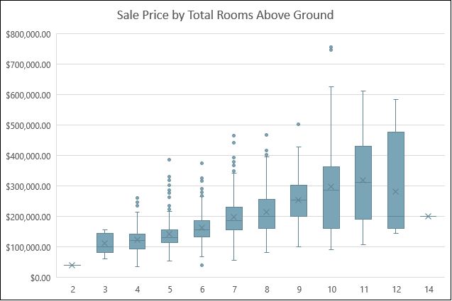
Total Rooms Above Ground
Analysis Results
Correlation: 0.534
T-tests:
Ho: μ1 - μ2 = 0 Ha: μ1 - μ2 ≠ 0
Separated by two groups: Total rooms <7 and Total rooms ≥7
P-value: 1.0968E-63 (<0.05)
Confidence interval: At the 95% confidence level, the difference of means (70849) is between 63,174 and 78,523.
Notes:
Total Rooms Above Ground

Slide 11
Year Built
Analysis Results
Correlation: 0.523
T-tests:
Ho: μ1 - μ2 = 0 Ha: μ1 - μ2 ≠ 0
Separated by two groups: Year Built <1971 and Year Built ≥1971
P-value: 1.19022E-89 (<0.05)
Confidence interval: At the 95% confidence level, the difference of means (77008) is between 70,081 and 83,936.
Notes:
Total Rooms Above Ground

Slide 12
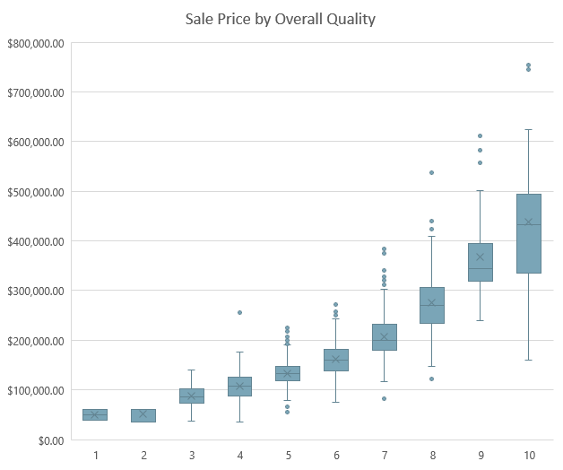
Year Built
Analysis Results
Correlation: 0.523
T-tests:
Ho: μ1 - μ2 = 0 Ha: μ1 - μ2 ≠ 0
Separated by two groups: Year Built <1971 and Year Built ≥1971
P-value: 1.19022E-89 (<0.05)
Confidence interval: At the 95% confidence level, the difference of means (77008) is between 70,081 and 83,936.
Notes:
Total Rooms Above Ground

